Slide 1
Sprint #3
IGVC
AutoMav
Dario Ugalde, Awet Tesfamariam, Andrew Break, Amgad Alamin, Warren Smith

Slide 2
Sprint Goal
Architecture Design document creation

Slide 3
Sprint Backlog (Design)
Item | Time Estimate (hours) | Iteration 1 | Iteration 2 | Iteration 3
Computer Vision | 4 | 1.5 | 0 | 0
Central Control | 3 | 0 | 1 | 1
Navigation | 4 | 1.5 | 0.5 | 0
Hardware | 3 | 1 | 1 | 1
Internal Sensors | N/A | 0 | 0 | 0.2
External Sensors | N/A | 0 | 0 | 0.5

Slide 4
Sprint Backlog (Documentation)
Item | Time Estimate (hours) | Actual Time
Computer Vision | 5 | 2
Central Central | 4 | 1
Navigation | 5 | 2
Hardware | 5 | 4
Internal Sensors | N/A | 1
External Sensors | N/A | 2
General ADS sections (Includes Diagrams) | N/A | 2

Slide 5
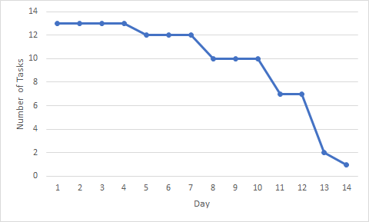
Burndown Chart

Slide 6
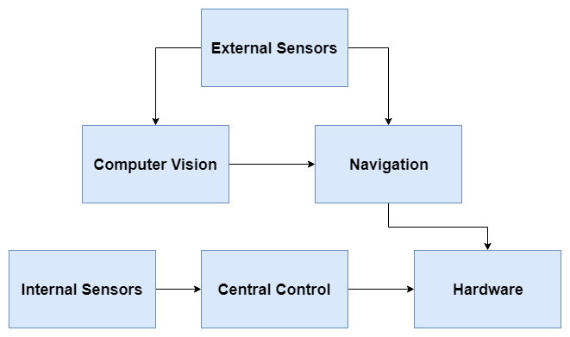
Final High Level Architecture

Slide 7
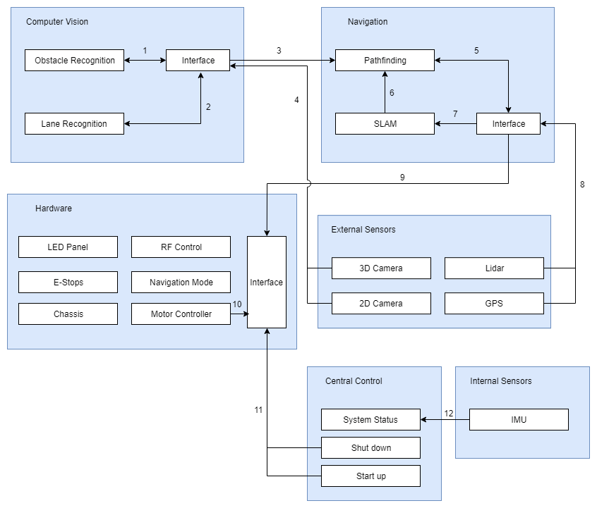

Slide 8
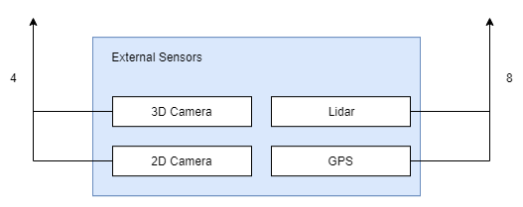
External Sensors

Slide 9
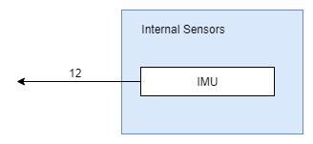
Internal Sensors

Slide 10
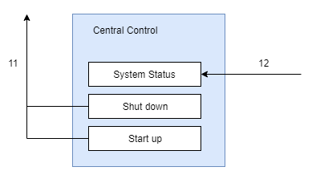
Central Control

Slide 11
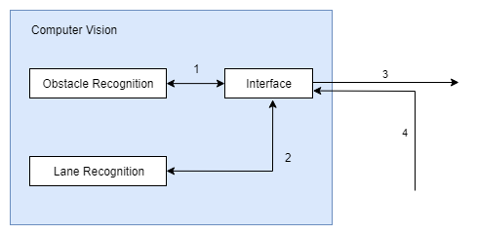
Computer Vision

Slide 12
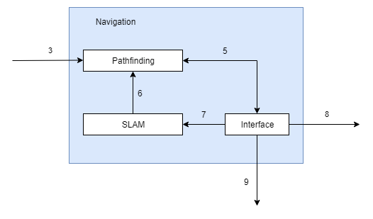
Navigation

Slide 13
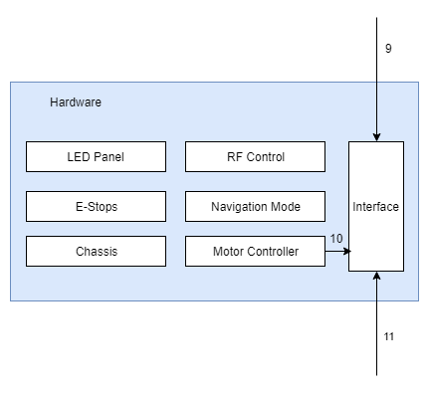
Hardware

